Slide 1


Smart Mobility Engineering Lab (ISE3231)
Week _ Lecture
ISE Department Prof. Mehdi Pirahandeh
School of Global Convergence Studies

Slide 2

ROS Setup
1
School of Global Convergence Studies

Slide 3
Goals
____
____
____
School of Global Convergence Studies

Slide 4
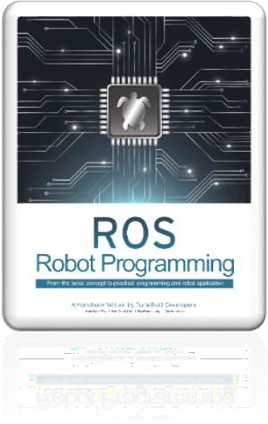
Contents
PC Setup
SBC Setup
OpenCR Setup
School of Global Convergence Studies

Slide 5
I. PC Setup

Slide 6
Download and Install Ubuntu on PC

Slide 7
Install ROS on Remote PC
Make sure your system is up-to-date
ubuntu@ubuntu:~$ sudo apt update
ubuntu@ubuntu:~$ sudo apt upgrade –y
Download ROS Noetic installation scripts
ubuntu@ubuntu:~$ wget https://raw.githubusercontent.com/ROBOTIS-GIT/robotis_tools/master/install_ros_noetic.sh
Run the script file
ubuntu@ubuntu:~$ chmod 755 ./install_ros_noetic.sh
ubuntu@ubuntu:~$ bash ./install_ros_noetic.sh

Slide 8
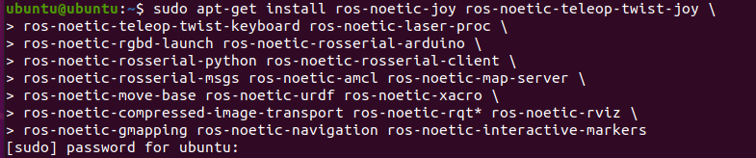
Install Dependent ROS Packages
Install ROS Packages
ubuntu@ubuntu:~$ sudo apt-get install ros-noetic-joy ros-noetic-teleop-twist-joy \
ros-noetic-teleop-twist-keyboard ros-noetic-laser-proc \
ros-noetic-rgbd-launch ros-noetic-rosserial-arduino \
ros-noetic-rosserial-python ros-noetic-rosserial-client \
ros-noetic-rosserial-msgs ros-noetic-amcl ros-noetic-map-server \
ros-noetic-move-base ros-noetic-urdf ros-noetic-xacro \
ros-noetic-compressed-image-transport ros-noetic-rqt* ros-noetic-rviz \
ros-noetic-gmapping ros-noetic-navigation ros-noetic-interactive-markers

Slide 9
Set TurtleBot3 Packages
Install TurtleBot3 via Debian Packages
ubuntu@ubuntu:~$ sudo apt install ros-noetic-dynamixel-sdk
ubuntu@ubuntu:~$ sudo apt install ros-noetic-turtlebot3-msgs
ubuntu@ubuntu:~$ sudo apt install ros-noetic-turtlebot3

Slide 10
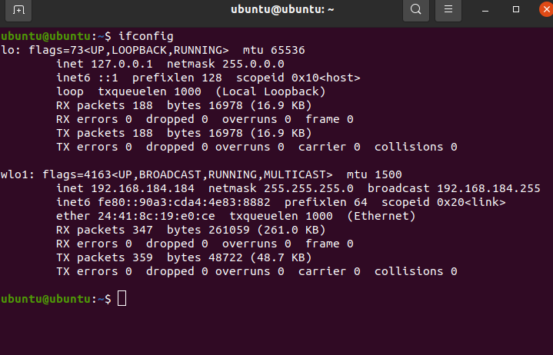
Network Configuration (Part I)
Install ROS Packages
ubuntu@ubuntu:~$ ifconfig
Install `net-tools` when `ifconfig` is not found
ubuntu@ubuntu:~$ sudo apt install net-tools
IP address [192.168.yyy.zzz]

Slide 11
Network Configuration (Part II)
Modify the address of `localhost` in the `ROS_MASTER_URI` and `ROS_HOSTNAME` with the IP address acquired
ubuntu@ubuntu:~$ echo ”export ROS_MASTER_URI=http://192.168.yyy.zzz” >> ~/.bashrc
ubuntu@ubuntu:~$ echo ”export ROS_HOSTNAME=192.168.yyy.zzz” >> ~/.bashrc
ubuntu@ubuntu:~$ source ~/.bashrc

Slide 12
II. SBC Setup

Slide 13
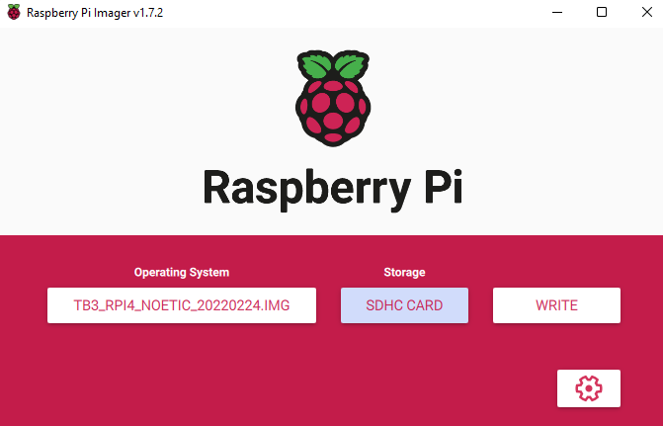
SBC Setup
Prepare microSC Card and Reader
Download TurtleBot3 SBC Image
https://www.robotis.com/service/download.php?no=2066
* this image may not be compatible with Raspberry Pi 4B with 8GB RAM
Unzip the downloaded image file and save it in the local disk
Burn the image file
You can use various
image burning tools

Slide 14
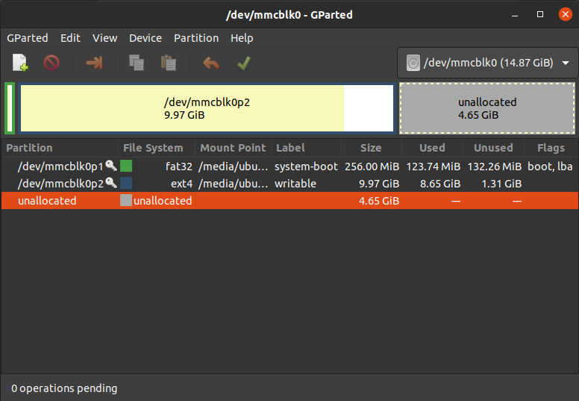
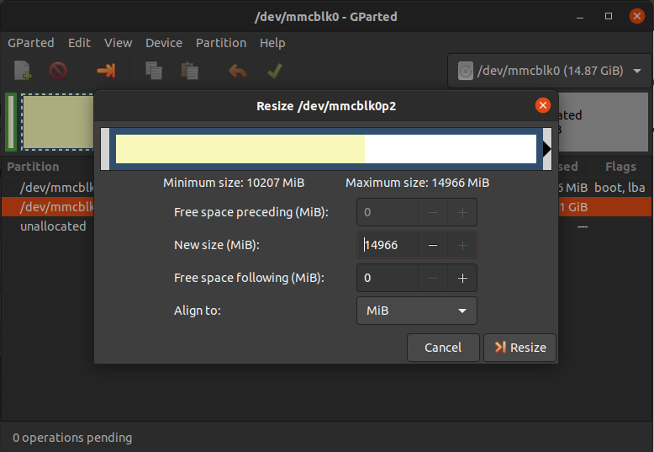
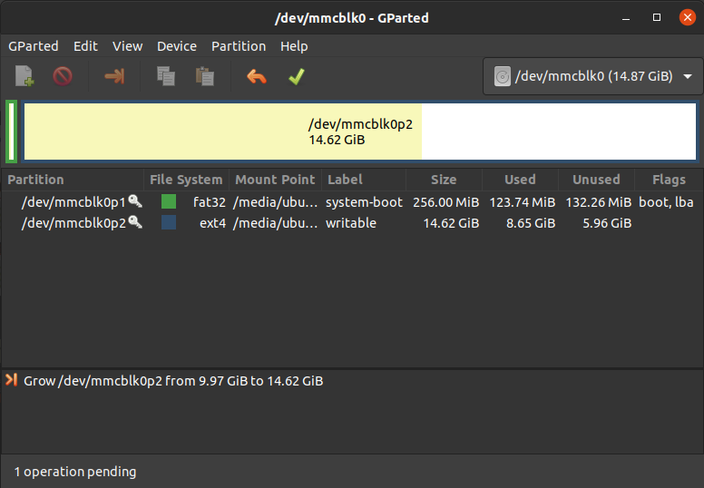
Resize the Partition
Install `GParted` GUI tool
ubuntu@ubuntu:~$ sudo apt install gparted
Open `GParted` and resize the Partition
ubuntu@ubuntu:~$ gparted
(1) right click on the partition and select Resize/Move
(2) resize the partition for maximum size and press Resize button
(3) press Apply button and finish resizing the partition

Slide 15
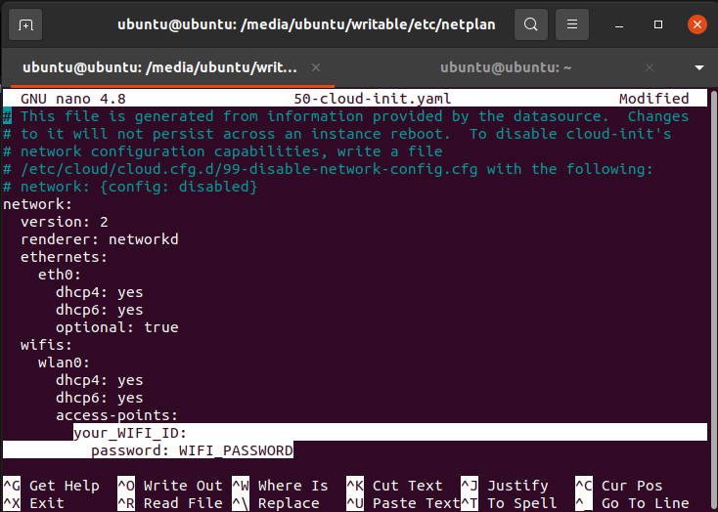
Configure the WiFi Network Setting (Part I)
Make sure your system is up-to-date
ubuntu@ubuntu:~$ cd /media/$USER/writable/etc/netplan
* in this case $USER is `ubuntu`
ubuntu@ubuntu:~$ sudo nano 50-cloud-init.yaml
Save the file by pressing `Ctrl+S` and
exit with `Ctrl+X`

Slide 16
Configure the WiFi Network Setting (Part II)
Boot Up the Raspberry Pi
Connect the HDMI cable of the monitor to the HDMI port of Raspberry Pi
Connect input devices to USB port of Raspberry Pi
Insert the microSD card
Connect the power to turn on the Raspberry Pi (*either with USB or OpenCR)
Login with ID `ubuntu` and PASSWORD `turtlebot`
ID: ubuntu
PASSWORD: turtlebot
ROS Network configuration
Confirm the WiFi IP address
ubuntu@ubuntu:~$ ifconfig
Find the `ROS_MASTER_URI` and `ROS_HOSTNAME` and modify the IP addresses
ubuntu@ubuntu:~$ nano ~/.bashrc
export ROS_MASTER_URI=http://{IP_ADDRESS_OF_REMOTE_PC}:11311
export ROS_HOTNAME={IP_ADDRESS_OF_RASPBERRY_PI}
*save and exit the nano editor: `Ctrl+S` → `Ctrl+X`
ubuntu@ubuntu:~$ source ~/.bashrc

Slide 17
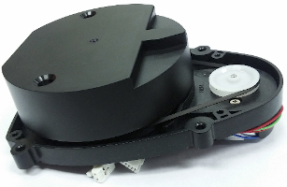
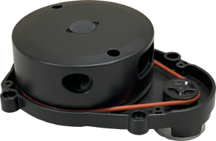
NEW LDS-02 Configuration
LDS-01 LDS-02
The TurtleBot3 LDS has been updated to LDS-02 since 2022 models
Install the LDS-02 driver and update TurtleBot3 package
ubuntu@ubuntu:~$ sudo apt update
ubuntu@ubuntu:~$ sudo apt install libudev-dev
ubuntu@ubuntu:~$ cd ~/catkin_ws/src
ubuntu@ubuntu:~$ git clone -b develop https://github.com/ROBOTIS-GIT/ld08_driver.git
ubuntu@ubuntu:~$ cd ~/catkin_ws/src/turtlebot3 && git pull
ubuntu@ubuntu:~$ rm -r turtlebot3_description/ turtlebot3_teleop/
turtlebot3_navigation/ turtlebot3_slam/ turtlebot3_example/
ubuntu@ubuntu:~$ cd ~/catkin_ws/ && catkin_make
Export the LDS_MODEL to the bashrc file
ubuntu@ubuntu:~$ echo ”export LDS_MODEL=LDS-02” >> ~/.bashrc

Slide 18
II. OpenCR Setup

Slide 19
OpenCR Setup
Connect OpenCR to the Raspberry Pi using the micro USB cable
Install required packages on the Raspberry Pi to upload OpenCR firmware
ubuntu@ubuntu:~$ sudo dpkg –add-architecture armhf
ubuntu@ubuntu:~$ sudo apt-get update
ubuntu@ubuntu:~$ sudo apt-get install libc6:armhf
ubuntu@ubuntu:~$ export OPENCR_PORT=/dev/ttyACM0
ubuntu@ubuntu:~$ export OPENCR_MODEL=burger_neotic
Download the firmware and loader
ubuntu@ubuntu:~$ rm -rf ./opencr_update.tar.bz2
ubuntu@ubuntu:~$ wget https://github.com/ROBOTIS-GIT/OpenCR-Binaries/raw/master/turtlebot3/ROS1/latest/opencr_update.tar.bz2
ubuntu@ubuntu:~$ tar -xvf opencr_update.tar.bz2
Upload firmware to the OpenCR
ubuntu@ubuntu:~$ cd ./opencr_update
ubuntu@ubuntu:~$ ./update.sh $OPENCR_PORT $OPENCR_MODEL.opencr

Slide 20
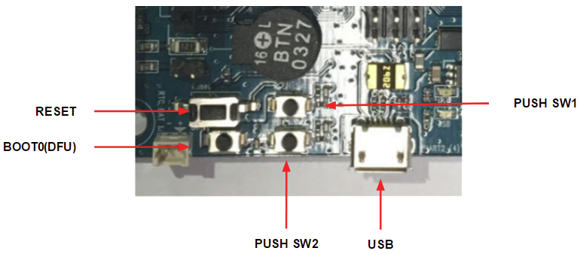
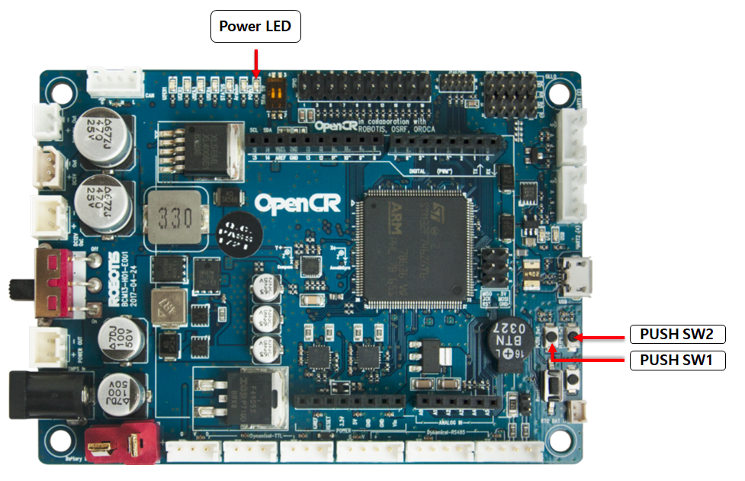
OpenCR Test
Connect the power to OpenCR and turn on the switch of OpenCR (*the `Power LED` will be turned on)
Place the robot on the flat ground in a wide-open area.
Press and hold `PUSH SW1` for a few seconds to command the robot to move 30 cm
Press and hold `PUSH SW2` for a few seconds
to rotate 180 degrees in place

Slide 21
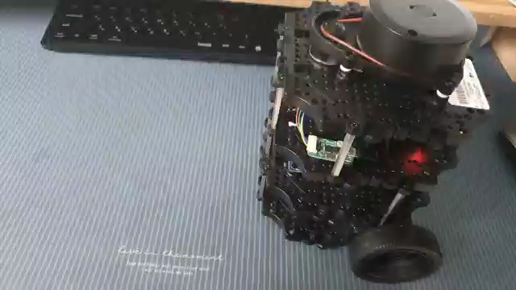
OpenCR Test Video

